Slide 1

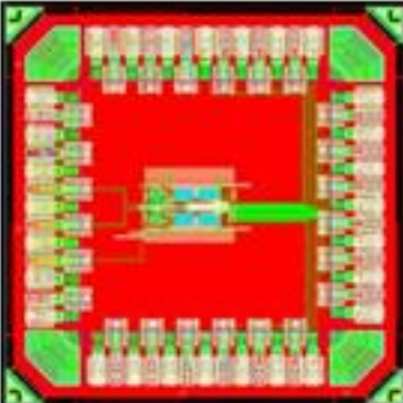
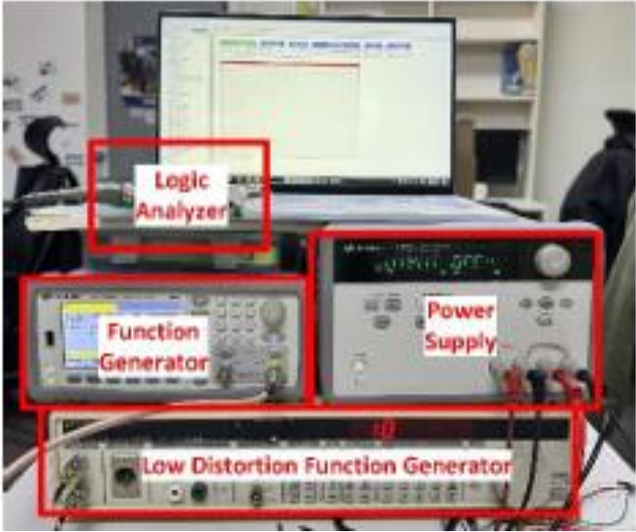
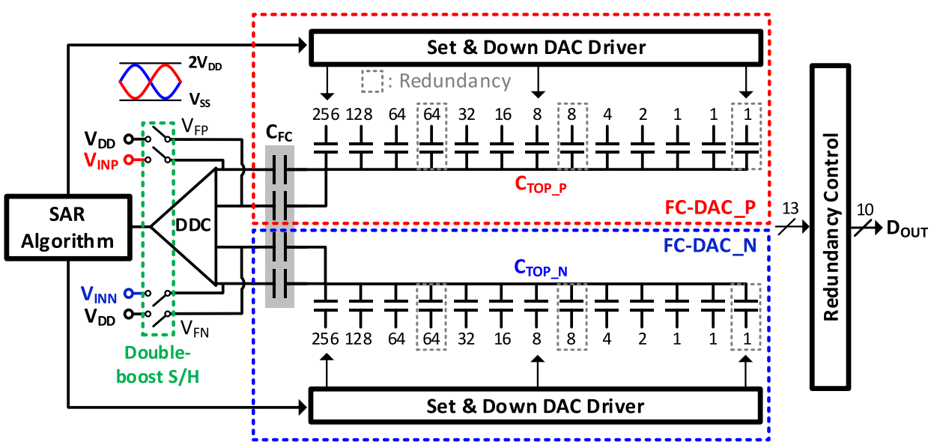
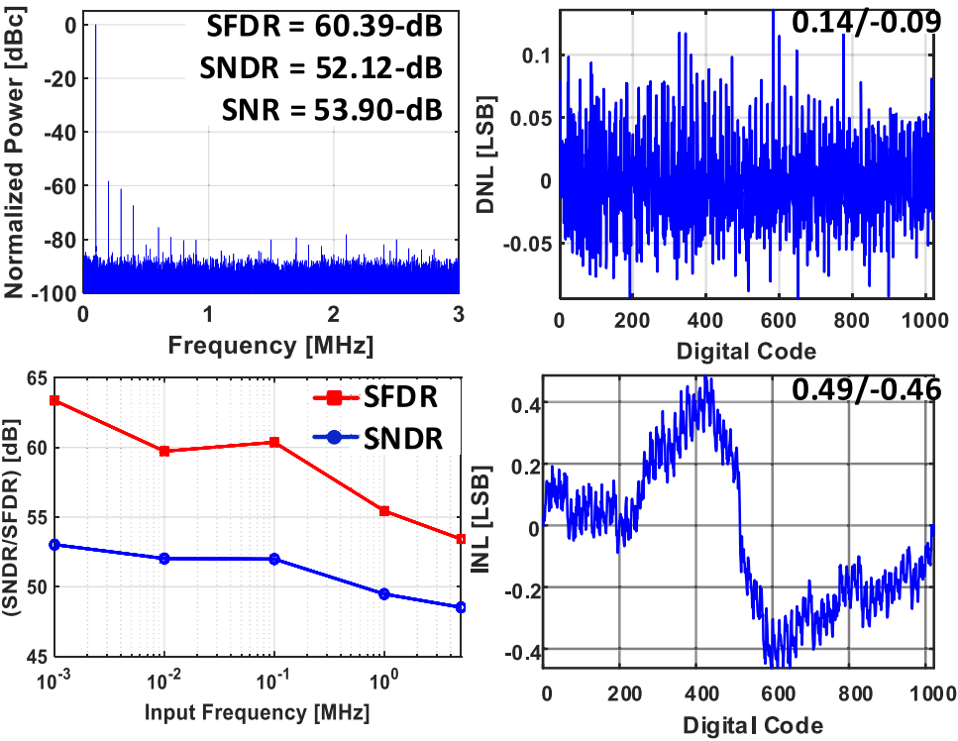
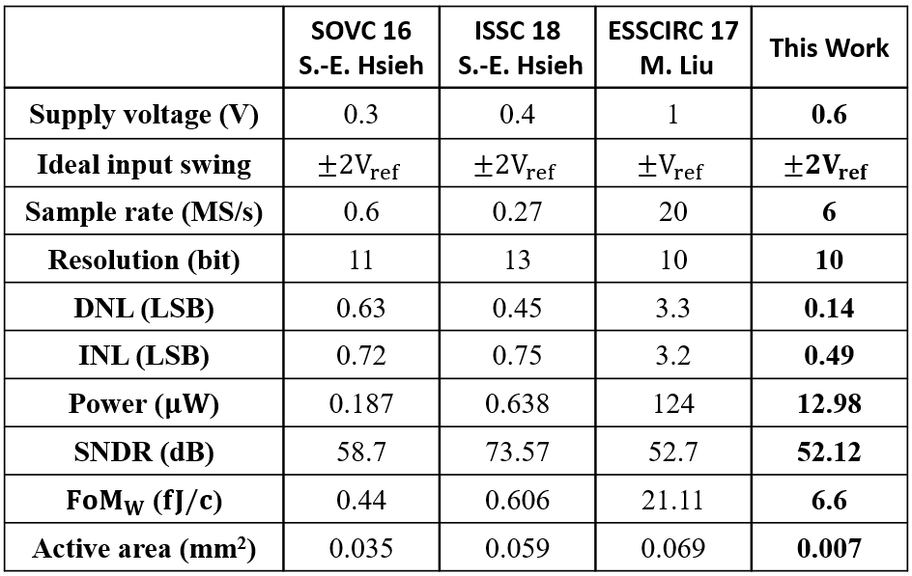
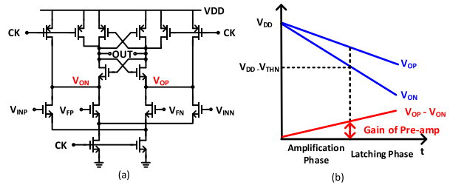
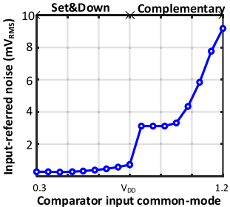

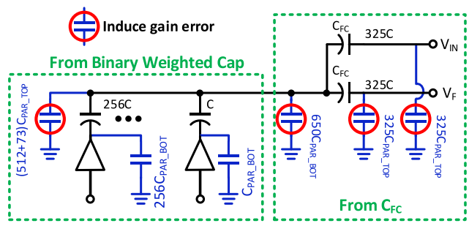
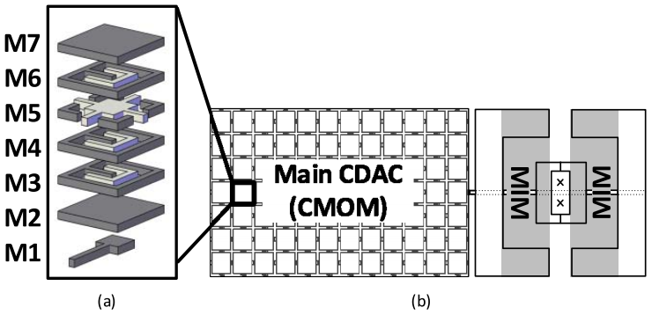
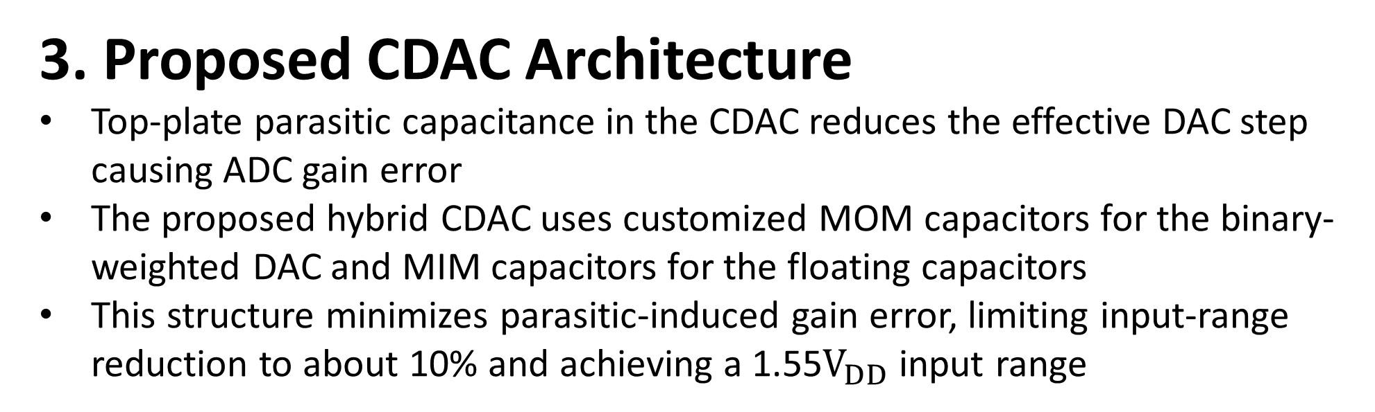
A High-Efficiency Low-Power 6MS/s SAR ADC with
Double Rail-to-Rail Operation
Jeetaeck Seo¹ , JongHyeon Seo² , Dong-Hyun Shin³ , Chunghee Jang⁴ , Jaesoub Han⁵ , Jeonghun Lee⁶ , Tae-hyun Kim⁷
and Kwang-Hyun Baek*
¹Department of Intelligent Semiconductor Engineering, Chung-Ang University, Seoul, Korea
Abstract
A 0.007mm² 0.6V 6MS/s 10-bit SAR ADC with a double rail-to-rail input range, designed for extended application use, including compute-in-memory (CIM) systems. The proposed ADC achieves area efficiency by requiring only two additional series connected capacitors and a differential-difference comparator for double rail-to-rail operation. Furthermore, the set-and-down operation reduces the input referred noise of the comparator , achieving over ten times lower noise than complementary switching. To improve accuracy, a hybrid capacitor DAC, combining metal-insulator-metal(MIM) and metal-oxide-metal(MOM) capacitors is employed to minimize gain error
3. Proposed CDAC Architecture
Top-plate parasitic capacitance in the CDAC reduces the effective DAC step causing ADC gain error
The proposed hybrid CDAC uses customized MOM capacitors for the binary-weighted DAC and MIM capacitors for the floating capacitors
This structure minimizes parasitic-induced gain error, limiting input-range reduction to about 10% and achieving a 1.55$V_{DD}$ input range
Introduction
Since ADCs contributed significantly to both power consumption and area in computer in memory (CIM) application, optimizing their efficiency is crucial. So, this proposal introduces a low power double rail-to-rail SAR ADC to expand applicability of low-power SAR ADCs in compute-in-memory (CIM) using only a single CDAC per side and reducing area requirements while maintaining performance
Measurement Result
1. Chip Implementation & Measurement Setup
Fabricated in 28 nm LPP process
Chip area: 4 mm × 4 mm (Mixed)
Core area: 0.007 mm²
Test board with power supply, Low Distortion Function Generator, Function Generator, Logic Analyzer
Proposed Double Rail-to-Rail SAR ADC
(a)
(b)
Fig. 4. (a) The layout of the proposed circuit
(b) Measurement setup for the proposed chip test.
2. Measured Results & Comparison
DNL : +0.14/-0.09LSB , INL : +0.49/-0.46LSB
SNR : 53.90 dB , SNDR : 52.12 dB , SFDR : 60.39 dB
(@ 100KHz Input Signal)
Fig. 1. Proposed double rail-to-rail SAR ADC architecture
Proposed Architecture
The proposed SAR ADC achieves double rail-to-rail input range using FC-DACs,
a Differential Difference Comparator, double-boost S/H switches, and SAR logic
The FC-DAC enables wide input conversion with reduced noise impact, while set-and-down switching improves comparator noise performance by lowering the input common-mode voltage
(a)
(b)
Fig. 2. (a) Differential-Difference Comparator schematic and operation (b) Input referred noise of comparator with different switching
Fig. 5. (a) Measured static and dynamic performance
(b) Performance Comparison
2. Set & Down Switching For Gain Enhancement
Double rail-to-rail operation increases the input range, but high input common-mode voltage degrades comparator gain and noise performance
Set-and-down switching lowers the common-mode during conversion, improving decision accuracy and enabling reliable wide-range conversion
Conclusions
This work presents a low-power double rail-to-rail SAR ADC that extends the input range for supply-scaled applications such as CIM.
Area efficiency is achieved using only a series-connected capacitor and a DDC, while set-and-down switching improves comparator noise performance . A hybrid CDAC combining customized MOM and MIM capacitors minimizes gain error, making the ADC suitable for compact and wide-input-range CIM systems.
Acknowledgement
The chip fabrication and EDA tool were supported by the IC Design Education Center(IDEC), Korea.
This paper was supported by Korea Planning & Evaluation Institute of Industrial Technology(KEIT)(2410000542, RS-2024-00403483) funded by the Ministry of Trade, Industry & Energy (MOTIE, Korea)
This paper was supported by Korea Planning & Evaluation Institute of Industrial Technology(KEIT)(RS-2025-02413438) funded by the Ministry of Trade, Industry & Energy (MOTIE, Korea)
Fig. 3. (a) Effect on ADC gain error according to the position of parasitic capacitance (b) Overall structure of CDAC

